Slide 1
TYPES OF EXPLOSIVES AND ACCESSORIES USED IN MINES
.

Slide 2
www.MINEPORTAL.in
ONLINE TEST SERIES FOR
GATE MINING
COAL/METAL FIRST/SECOND CLASS
COAL INDIA MT MINING EXAM
OVERMAN/SIRDAR EXAM
OTHER PSU MANAGEMENT TRAINEE EXAM
FREE STUDY MATERIAL/VIDEO LECTURES
ONLINE ORDER MINING BOOKS
CALL/WHATSAPP-8804777500 www.fb.com/mineportal.in

Slide 3
EXPLOSIVE DEFINITIONS
  1. Explosive is a substance, which under the influence of heat, shock or both, is capable of generating a large volume of gas at high temperature in an extremely short space of time on confined rock mass, thus breaking it.
  2. The Explosive Act, 1884 defines “Explosive” means gunpowder, NG, nitroglycol, guncotton, dinitrotoluene, tri-nitrotoluene,picric acid, dinitro phenol, trinitro resorcinol, cyclotrimethylene-trinitramine, penta-erythritol-tetranitrate,tetryl,fulminate of mercury or any other metal, diazo-di-nitro phenol, coloured fires or any other substance whether a single chemical compound or a mixture of substance, whether solid or liquid or gaseous used or manufactured with a view to produce a practical effect by explosion or pyrotechnic effect, and it inlcudes fog signals, fireworks, fuses, rockets, detonators, ammunition of all descriptions and every adaption or preparation of an explosive as defined in this clause.

Slide 4
CLASSIFICATION OF EXPLOSIVES
As per Explosive Rules
  Class I : Gunpowder
  Class II : Nitrate mixture
  Class III : nitro compounds
    Div 1 – BG, special gelatin
    Div 2 – Guncotton, PETN, TNT etc.
  Class IV : Chlorate mixture
  Class V : Fulminate
  Class VI :
    Div 1- Safety fuse, Ignitor cord, etc
    Div 2 – DF/D cord, electric fuse, etc.
Based on Sensitivity
  Cap Sensitive – detonated by detonator ex: permitted, etc.
  Non – Cap sensitivity – explosives cannot be detonated and need a cap sensitive explosive for detonation ex: ANFO etc.

Slide 5
Based on risk:
  Category X - explosives have a fire or a slight explosion risk
  Category Y – mass fire risk or moderate explosion risk but not mass explosion.
  Category Z – mass explosion risk and major missile effect
  Category ZZ – mass explosion risk and minor missile effect
  Based on Strength:
    Low explosive – gunpowder etc.
    High explosive – dynamites, slurry, emulsion etc.
    Use Basis
      Permitted Explosives – used in UG gassy coal/non coal mines or excavations.
      Non permitted
        Small dia– 32mm holes drilled by jack hammers.
        Large dia – 100 mm dia or more.

Slide 6
LOW EXPLOSIVE
Oldest form of explosive.
Gun powder/ black powder
It burns and develop much low pressure
It is a mechanical mixture of KNO3 (72-75%), charcoal (15-16%) and sulphur (10-12%)
20 KNO₃+30 C+10S → (6K₂CO₃+K₂SO₄+3K₂)+(14CO₂+10CO+10N₂)+600 cal/g
Poor fragmentation with heaving effect
Used in manufacture of safety fuse; extraction of ornamental blocks.
Used in small quarries, well digging etc.

Slide 7
HIGH EXPLOSIVES
Highly oxygen balanced, Characterized by very high rate of reaction and high detonation pressure.
2 types
  NG based (1845)
    Dyanmites (1860)
    Gelatines
  ANFO (1947)
    LOX (1930, in India)
    Slurry (1960-62)
    Cap-sensitive Slurry (1970)
    Emulsion (1978)
    Bulk Explosives (1980 -90)

Slide 8
NG based explosives
Yellow oily transparent liquid made by action of nitric acid on glycerine.
Compositions:
  NG-5%-90%
  NC-Gelling/thickening agent & senstizer
  Oxidizer-AN & SN
  Fuel ingredients- Starches, wood flours, sulfur; NaCl-in permissible exp.
Sensitive to shock, friction & heat
High VOD of 7800m/sec
Temp of detn.- 3150^{O} C
Chemical reaction:
(NG) 4C₃H₅ (NO₃) ₃ → 12CO₂+10H₂O+6N₂+O₂+1500 cal/g
Density:0.8-1.45, RBS: 73-79%, Temp.Res:17 deg

Slide 9
NG based explosives
Advantages:
High strengths
High densities
High detonation velocity
Greater water resistance and chemical stability
Disadvantages:
Risk of accidents
Sensitive to friction and heat
Handling problems
High manufacturing cost
Examples: TELGEX-80/90/LD (TEL), OCG(ICI).

Slide 10
Ammonium Nitrate Fuel Oil
94.3% AN +5.7% FO (Oxygen Balanced)
Chemical Reaction:
94.3%AN+5.7%FO (Oxygen balanced) - 3NH₄NO₃+CH₂ →3N₂+7H₂O+CO₂+930 cal/g
Fuel Oil –Diesel Oil No.2 ( for 50 kg of AN-3.7 liters)
Sensitivity and Performance of AN, depends on ‘quality’ of the Prill supplied
Sensitivity or Energy increased by adding Fuel grade Aluminum and affected by water
PROPERTIES:
  Density – 0.3 to 1 g/cc
  VOD – 2000 to 4000 m/s
  Gas volume – 9770 litres/cc
  Heat – 900 Kcal/Kg

Slide 11
ANFO
Advantages:
Superior in cost effectiveness
Safe to handle
Best suitable for dry holes
Explosive is prepared only at the site
No storage in magazine required
Disadvantages:
Desensitized in water
Inefficient in small dia holes
Unsuccessful blasting in hard rocks
Lower sensitivity
Examples: Deepak Fertilizers, Pune

Slide 12
LOX
It is made by soaking cartridge of activated charcoal-27% (combustible ingredient) - in liquid oxygen (73%).
High detonation pressure (14*10000 atmos.) and explosion temperature (6600 degree C)
Large volume of gas is released at high temperature
Advantages:
Suitable for dense and medium rocks
No emission of noxious gases
It causes less vibrations than conventional explosive
Misfires can be handled safely after lapse of certain duration
Disadvantages:
Cost is high
Quicker evaporation ( life is shorter)
Unsafe
Example: LOXITE (IOL)

Slide 13
SLURRY
Addition of colloid such as ‘Guargum’ in ANFO, which builds up ‘Viscosity’, followed by Cross-linking agent which forms a gelled mixture.
Compositions:
Oxidizer: AN, SN
Fuel: Sugar, Coal.
TNT, Al- Sensitizer
Plant or Truck mixed
Detonation velocity: 3000-4500 m/sec
Density:1-1.2, RBS: 53-65%
Temperature resistance: 4 deg.C

Slide 14
.
Advantages:
Water resistant
Effective utilization of explosives
Not subjected to friction or impact
It produces low non-toxic fumes
Disadvantages:
Life is only 6 months
Not suitable for high temperature conditions
Example: TELGEL (TEL)

Slide 15
EMULSION
Consists of oxiders dissolved in water surrounded by a fuel – fine particle size
Senstizer: air/gas bubbles or artificial glass micro balloons-hot spot; Emulsifier-waxes, gums
VOD: 4000-5000 m/s
Density range of 1.1 to 1.35 g/cc
High water resistant in full concentration
Plant of Truck mixed
High velocity and bulk strength
Temperature resistance: 4 deg. C
Example: Powergel (Orica)

Slide 16
PERMITTED EXPLOSIVES
P1 – Unsheathed. simultaneous blasting in coal, ripping. Used for CCM. Used in Degree I mines
P2 – Sheathed. Replaced by P3 explosives.
P3 – Equivalent sheathed. Can be used in Degree II, III mines.
P4 – Ultrasafe explsoives. Not used in India.
P5 – Delay blasting in solid blasting and in gassy mines.

Slide 17
BULK EXPLOSIVES
Explosives directly delivered into the blast hole through mechanised and mobile delivery system
Supplied to large opencast mines and civil construction projects
Useful, annual explosive consumption-2000 t
Types – Bulk ANFO, Bulk Watergel, Bulk Emulsion, HANFO

Slide 18
BENEFITS OF BULK EXPLOSIVES
Safety
Inventory
Explosive vans
Manpower
Speed of operation
Explosive product
Blasting efficiency
Other features

Slide 19
BLASTING ACCESSORIES
Initiation / Firing Systems
  Non-Electric System
  Electric System
Exploders
Detonating Delay
Cord Relays

Slide 20
COMPARISON OF VARIOUS INITIATION SYSTEM
FEATURE | Shock Tube | HEDC+delay | Electric deto | Fuse+IC | LEDC
Timing ability | Precise | Limited | Precise | Limited | -
Blasting limited capability | Unlimited | Unlimited | Unlimited | Limited | -
Blasting adaptability | Most aspects | Mainly open pit blasting | Mainly UG blasting | Both | ANFO+large dia slurries
Air blast | None-existent | significant | None-existent | None-existent | Limited
Fire risk | None-existent | None-existent | None-existent | Existent | None-existent
Means of checking | Visual | visual | Instrumental | Visual | visual
Craftsmanship | unskilled | unskilled | skilled | Unskilled | unskilled

Slide 21
DETONATING CORD
It gets initiated by a detonator and in turn propagates the shock wave to the explosive column.
It has a core of PETN (varying from 3 to 80 gm/m), wrapped in plastic tape/nylon cord layer, textile layer and finally a plastic covering to give strength of 50 to 60 kg.
VOD of 6500 to 7000m/s.
It is insensitive to shock and flame.

Slide 22
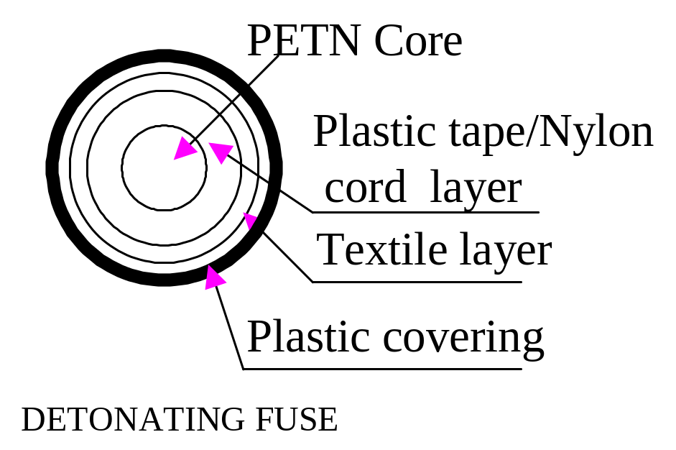

Slide 23
SHOCK TUBE SYSTEM
It is the down the line initiation system.
It comprising of high strength plastic/ polyfin polymer shock tube of 3-4mm outside diameter.
It is coated inside with a thin film of reactive explosive substance, HMX of 15-20mg/m.
There is a delay detonator attached at the end of tube. ‘Raydet’-developed by IDL, ‘Excel’-developed by ICI, ‘Amardet’- by Premier explosive Ltd.

Slide 24
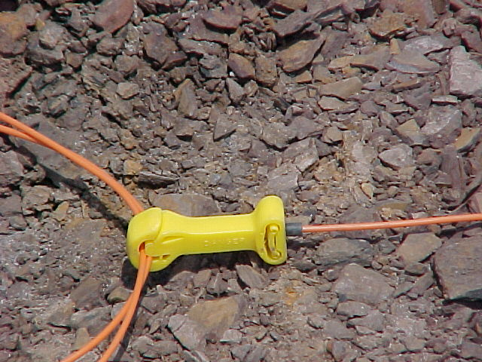

Slide 25
ADVANTAGES
True bottom initiation
Less air & ground vibration
Better high wall, roof and side stability
Not susceptible to stray electric currents, current leakage, radio frequency or static electricity, friction and impact
Better fragmentation.
Minimum pre mature venting through stemming.
Reduction in boulder generation
Improved toe- breakage
Reduced fly rock.
Improved cycle time

Slide 26
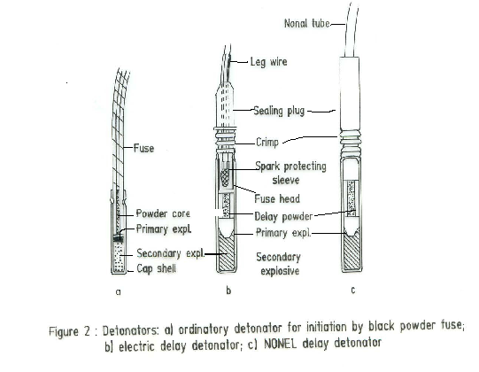

Slide 27
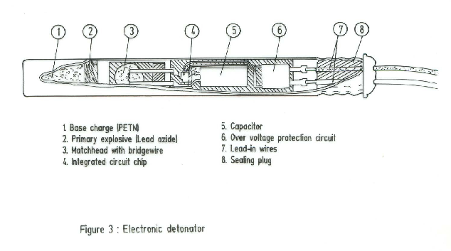

Slide 28
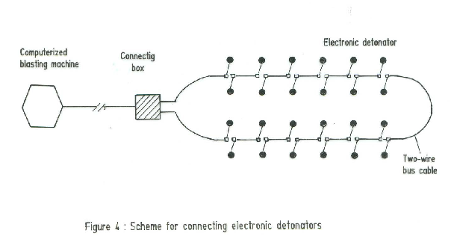

Slide 29
TUNNELLING
High density explosives are used.
NG being replaced by slurry (high density).
Shock tubes
  No premature explosion
  Accuracy in delay time sequencing.

Slide 30
ACCESSORIES
CIRCUIT TESTER
In electric shotfiring, the circuit is tested to
ensure that there is no open or short circuit
and such tests are being done by ‘Blastometer’.
CRIMPER
It is a pair of pliers to crimp or press the end of
a plain detonator tube on a safety fuse inserted
into it.

Slide 31
Shot firing cables
  To fire the shots from the long distance
Wooden stemming rod
  To stem the holes
Scraper
  To clean the holes.
Pricker
  To prick the cartridge and it is made of brass, aluminum or wood.

Slide 32
REFERENCES
G.K.Pradhan, explosives and blasting techniques.
D.J.Deshmukh, Elements of Mining Technology Vol.1
B.A.KENADY.,
Alan Bauer William A. Crosby - BLASTING

Slide 33
.
Thank you

